Slide 1
Lightning Talk 3
sdmay21-39

Slide 2
List Of Technical Challenges
Rishabh Bansal
Connecting to the Cloud
Getting the Resources
Hosting our Application
Choosing over SDKs(Ansible or Chef)
IAM configuration

Slide 3
Ansible
Adis Osmankic
Tool to hook into the cloud
Connecting to different clouds
Setting up the resources
Environment orchestrator
Notes:
A critical task in our project is administering services to the cloud. This created a major challenge because we needed to find a way to manage the cloud resources on our server and connect it to our user interface for convenient deployment. This problem was possibly the greatest technological challenge we had, so to solve it, we broke it down and tried to solve one piece at a time. The first piece to solve was how are we going to make a connection from our server to the cloud. We knew we were likely going to use some tool that could do this for us since it was unreasonable to expect to build out an entire toolset in the given timeframe. We then had to research available tools that met our description. We needed a tool that allowed for connecting to different cloud and on premises platforms. The tool needed to be affordable and dynamic while requiring little resources to run. This research then led us to choosing Ansible as our environment orchestrator. Ansible is a free tool that requires little resources and can be used to deploy to different platforms dynamically. This solved the first piece of the problem, but there are still more issues with connecting to cloud that we needed to reslove.

Slide 4
A Deeper Dive into Ansible: Azure
Jet
Setting up the control node (host machine)
Setting up credentials through the cloud platform
Persisting credentials
Why go through the trouble v.s. Just using a cloud providers API
Notes:
So, setting up ansible on each of the three cloud platforms is pretty similar. It really breaks down to 3 parts setting up a host machine, setting up credentials for ansible to use in the cloud environment, and persisting these credentials.
For azure it starts by making an ssh key. Whatever the permissions for the account that this key is associated with will be the permissions for ansible, so this will probably be an ansible specific account.
The host machine or control node of ansible will be the same one for each platform, and just use the appropriate creds for whichever environment the user selects.
Persisting these credentials for ansible to use is pretty similar across platforms. Azure recommends creating a credentials file and exporting to environment variables, where as AWS pushes using ansibles password vault, but both do effectively the same thing.
Circling back to the control node on this control node being shared and configured with credentials across platforms, and loading them into the appropriate playbook upon user selection. This lets us treat ansible as our single interface for interacting with cloud environments rather that using each cloud providers api.

Slide 5
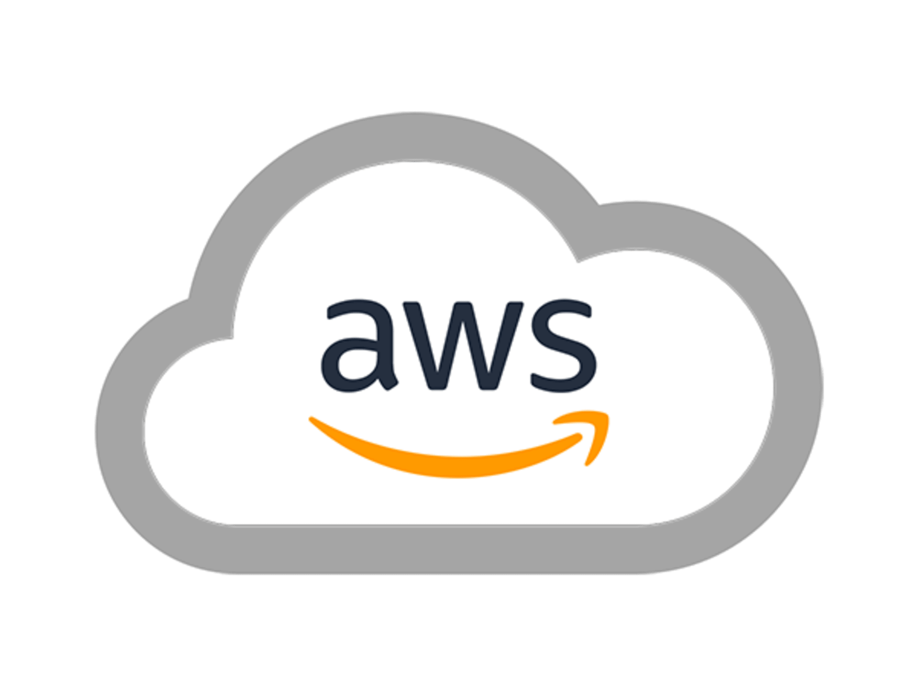
IAM Configuration
Zane Seuser
Start within Root Account
Limiting AWS Accessibility w/ Policies
Configuring Developer User
Associating Policies w/ Developer User
As Least Permissive As Possible
Notes:
As we began experimenting with Ansible, and the Amazon Web Services platform we quickly figured out that we need to configure IAM users and policies. As you may or may not know, when you create a fresh Amazon Web Services account, you start out as a root user, which is basically a super admin that can do anything and everything within the account. We found this to be an issue because we did not want to give the Ansible tool complete privileges to our account for security reasons. So, what we did is create a user and associated the policies that had the exact privileges that Ansible needed to provision our lab environments, and we gave those credentials to Ansible. This was a very good thing to do, because an Amazon IAM best practice is to be as least permissive as possible when handing out permissions to users and services.

Slide 6
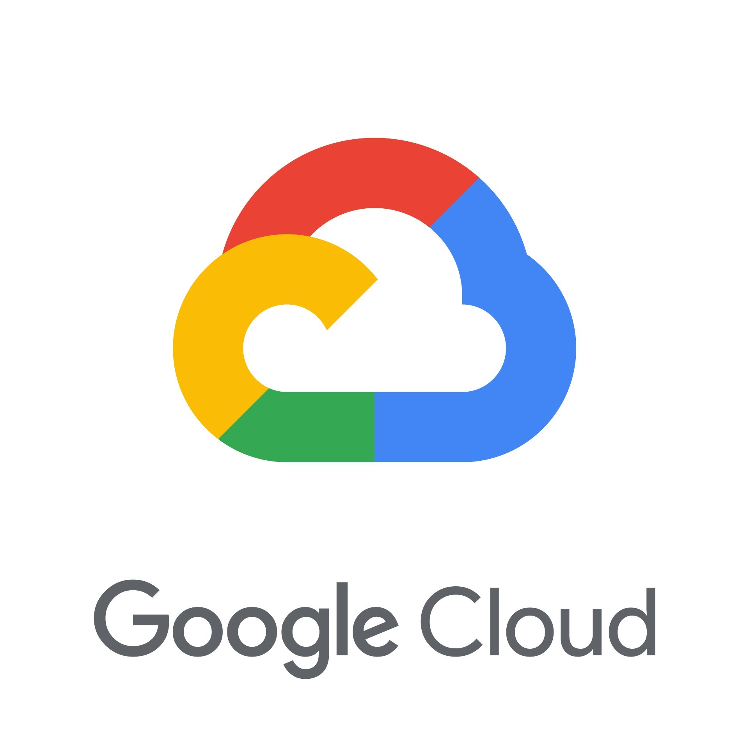
Google Cloud Platform
Gavin Monroe
Google Cloud Console
Cloud Documentation
Cloud Requirements
Service Integration
Hosting & Cost
Resources
And More
Notes:
Just like all the other Cloud platforms, Google Cloud Platform(or gcp for short) is just as complex as the rest. We consider GCP to be a big part of the solution as the client would like to have it implemented. GCP on its own could talk up 5 mins of coverage to brush over all its features, To keep it short we will be using GCP and implement its console solution to help us to spin up Virtual Machines for our end goal. To overcome this issue it will take a GCP playbook, documentation, and simple unit tests along with integration tests to have it fully implemented into our solution.

Slide 7
Thank you
Cloud Environment Manager

